Slide 1
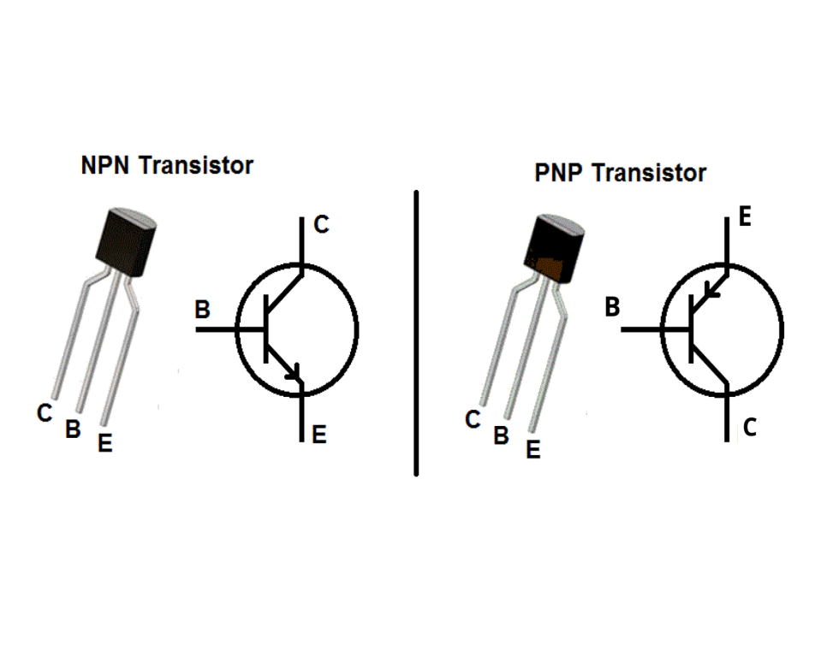
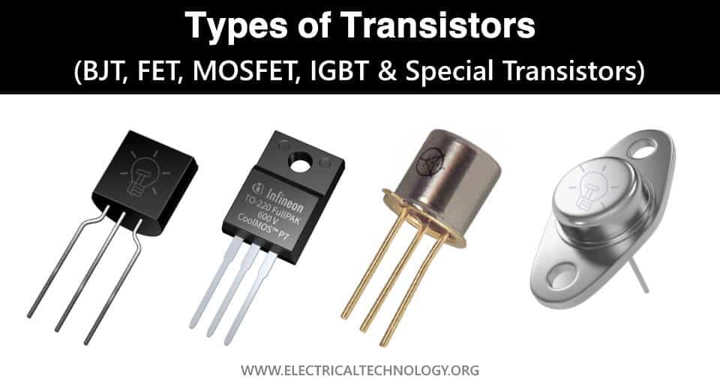
TRANSISTOR CIRCUITS
Transistors have mainly two uses
Transistor as a switch
Transistor as an amplifier.

Slide 2
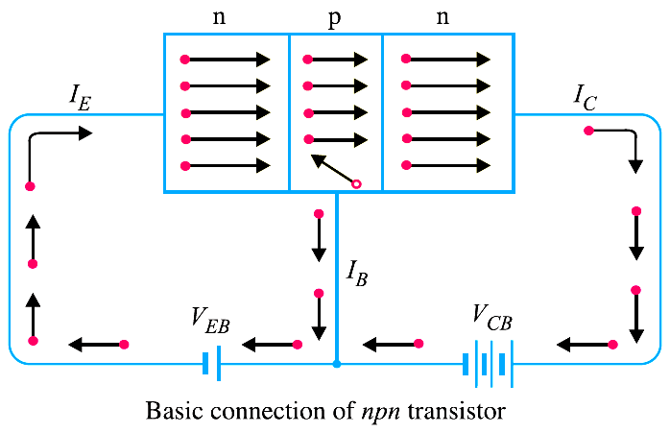
TRANSISTOR AS A SWITCH
Transistor can act as a switch we can control high current(collector current) by using low current(base current) in a typical npn transitor.
Base current<<Collector current

Slide 3
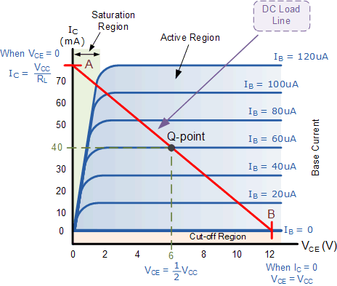

Slide 4
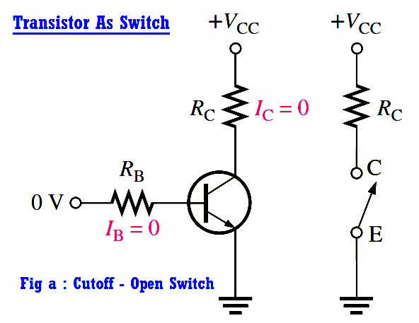
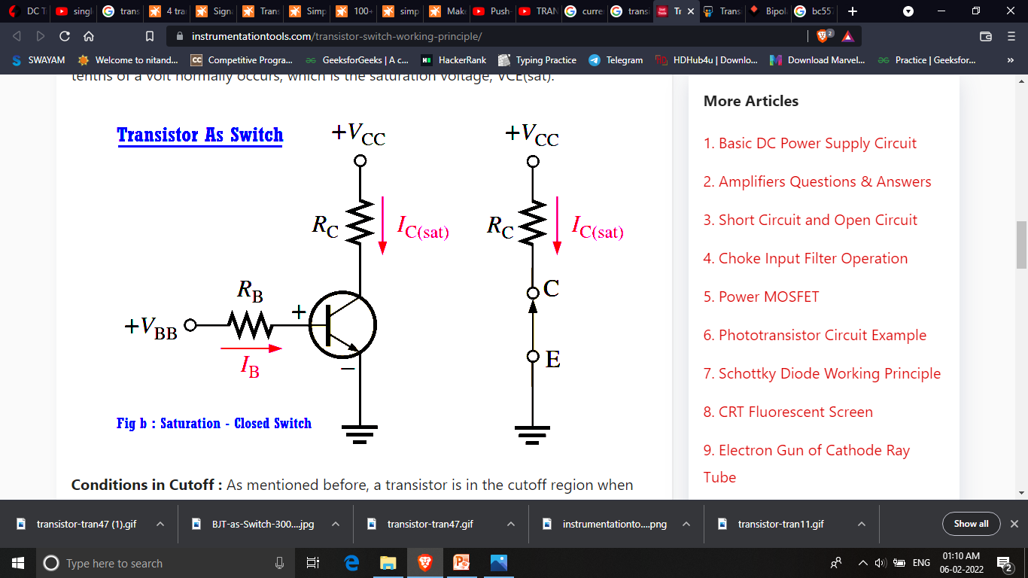

Slide 5
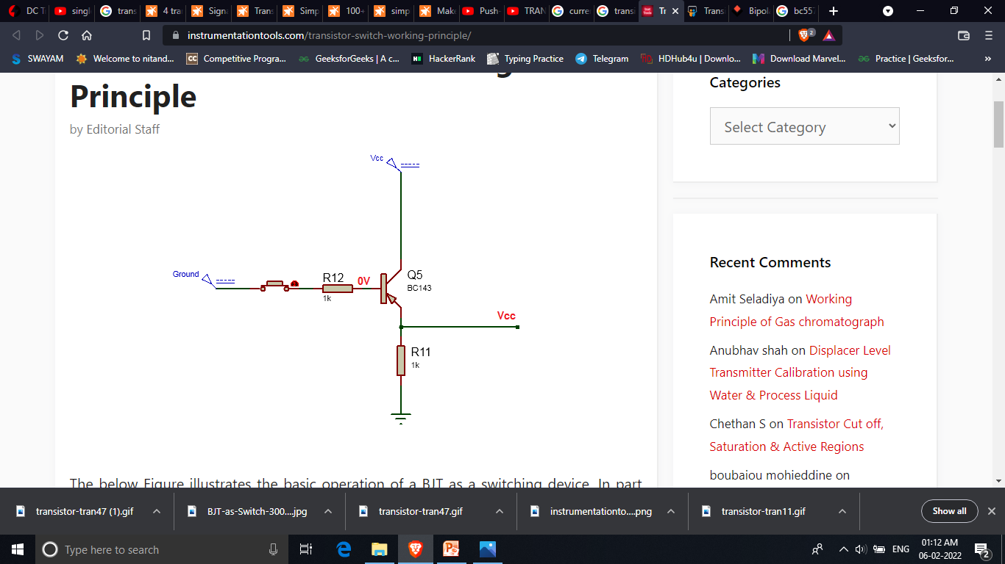


Slide 6
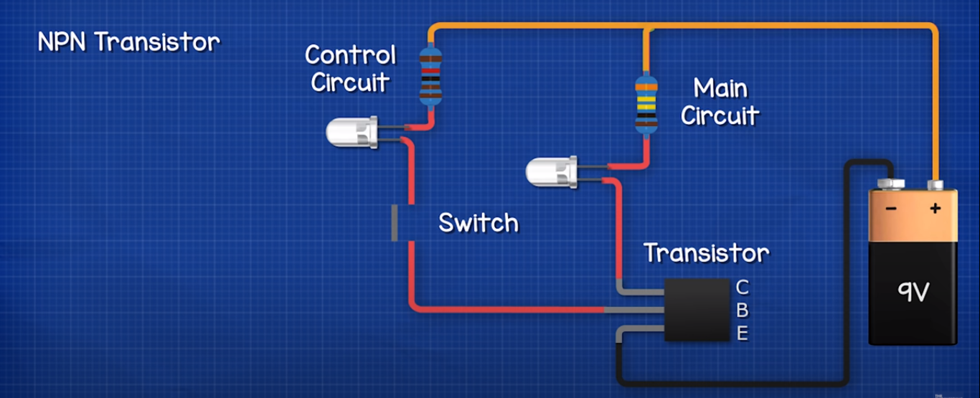
Here we are controlling current in main using by controlling
current through base of a transistor.

Slide 7
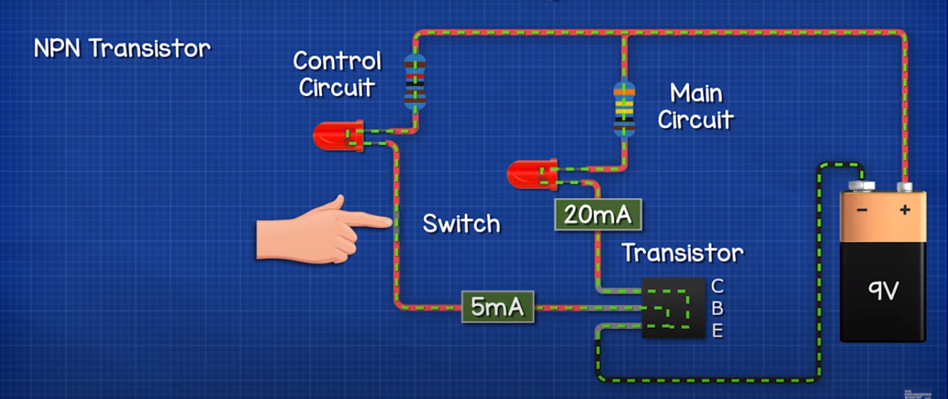
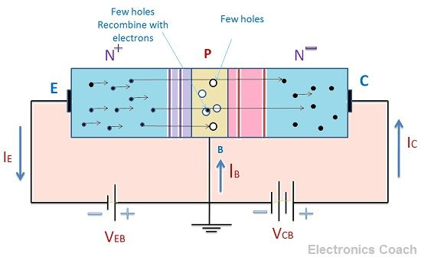

Slide 8
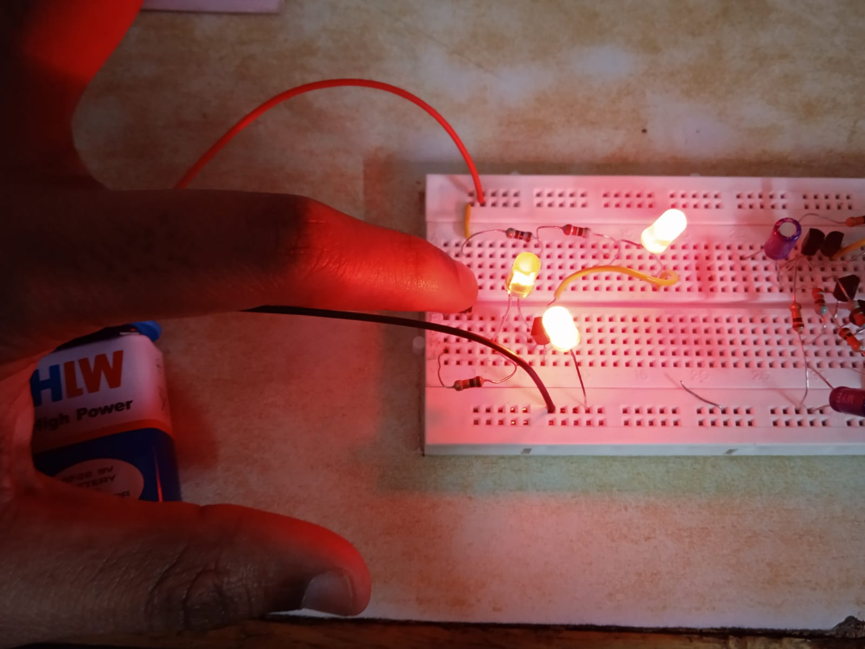
Transistor working as closed switch

Slide 9
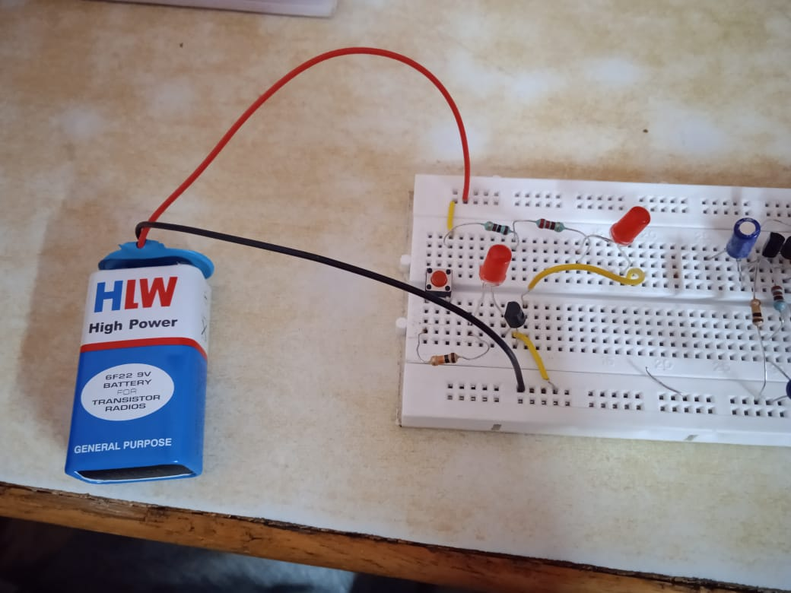
Transistor as open switch

Slide 10
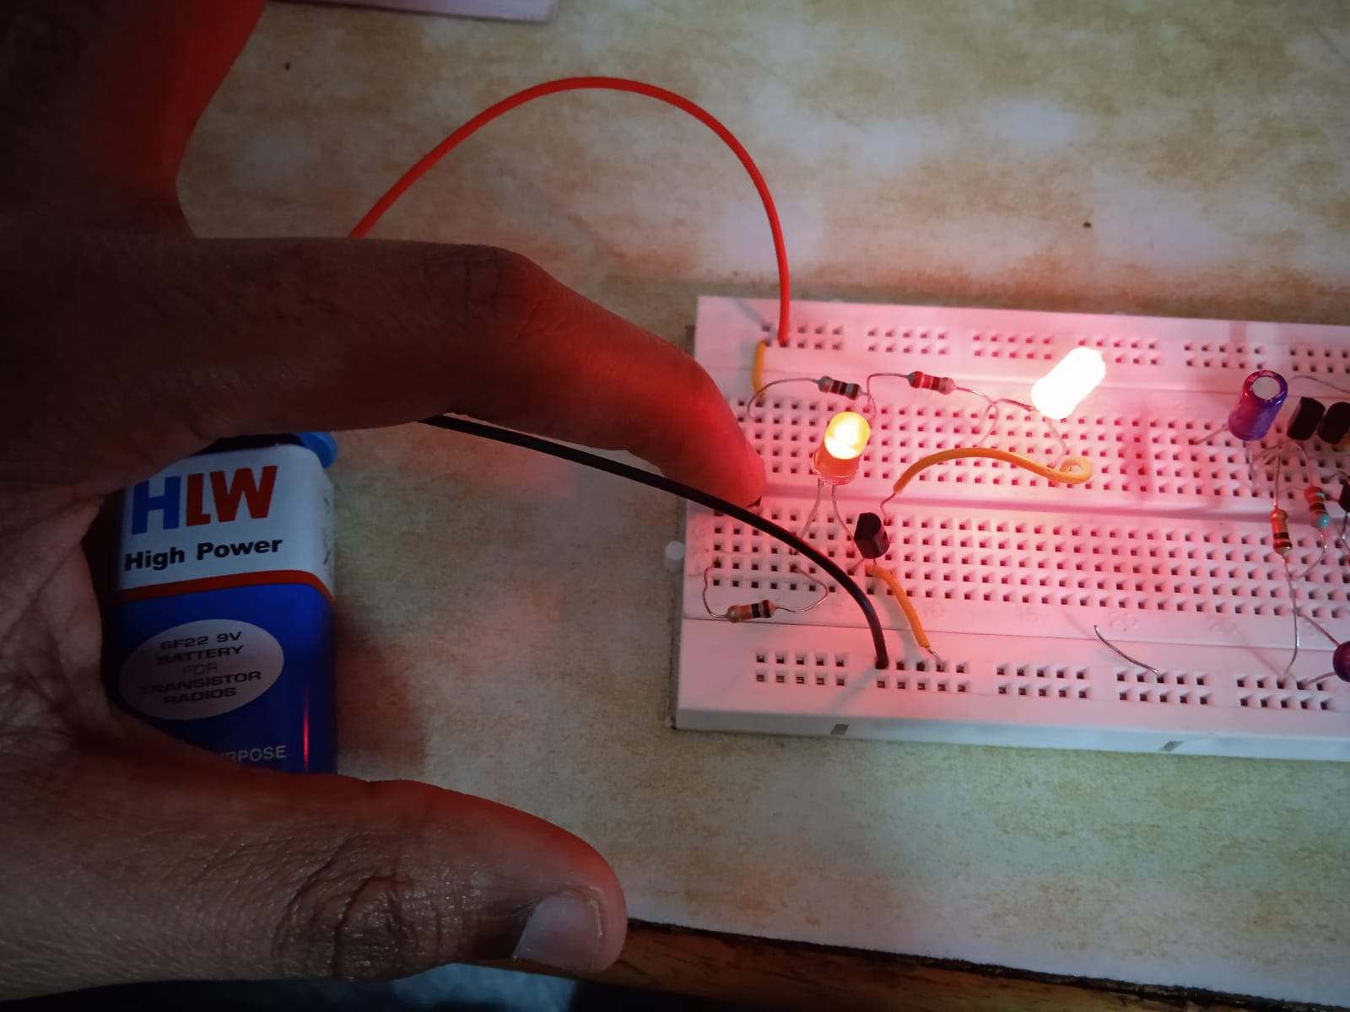
Transistor as an amplifier

Slide 11
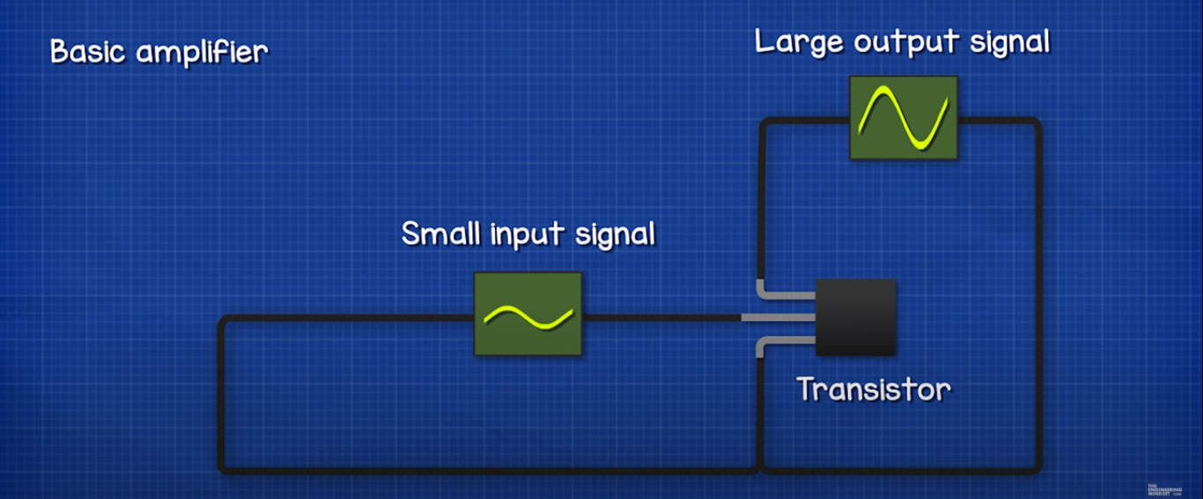
TRANSISTOR AS AN AMPLIFIER

Slide 12

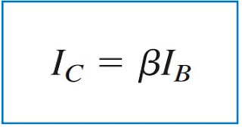
Here the base current(Ib) is smaller compared to Collector Current(Ic)

Slide 13
Since β in above Equation is large, a small base current controls the large current in the output circuit. Consequently it can be used as an amplifier.

Slide 14
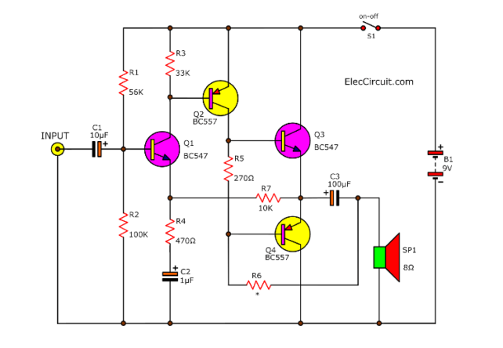
4 Transistor push pull amplifier

Slide 15
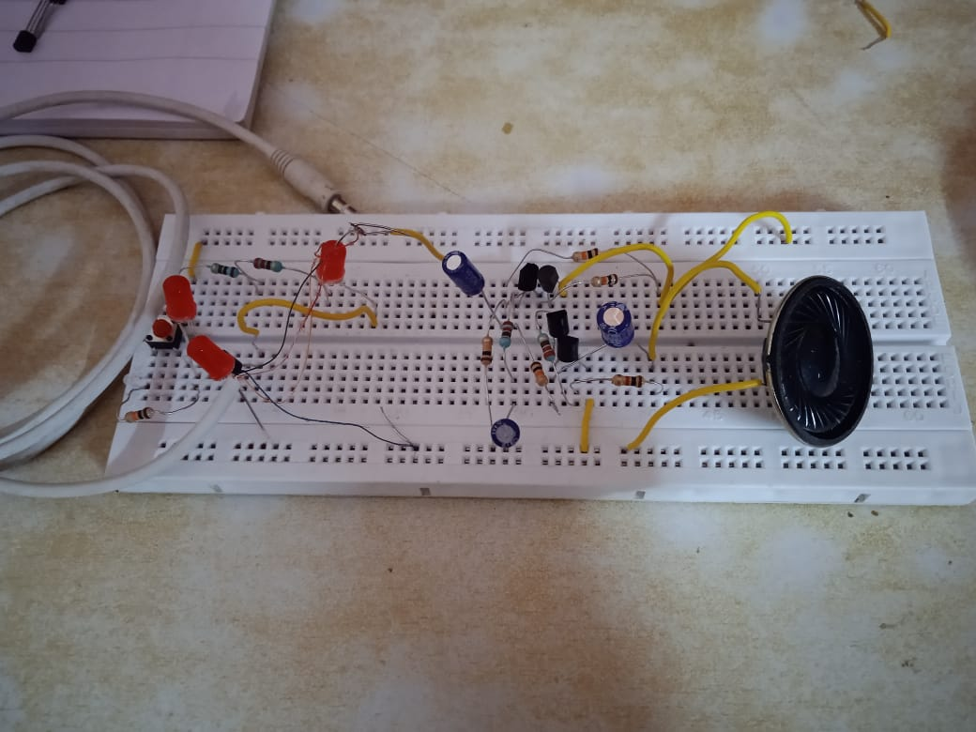

Slide 16
This needs to reduce cross-over distortion which occurs whenever two transistors are connected in push-pull
Both transistors Q3 and Q4 are arranged as a complementary pair operating in push-pull. Each output transistor deals with one half of the audio cycle, one being cut-off when the other conduct.
Next, the Q1 and Q2 transistors run as a pre-amp to increase the incoming voltage to drive the output pair.
Then, at Q1 the bias of the whole circuit commences with the voltage divider made up of the 56K and 100K resistors.

